Slide 1


Federated Data Analytics for Genomics Data
Student: Mirco CAZZARO – mat. 2076745
Supervisor: Prof. Gianmaria SILVELLO
Master Degree Course in Computer Engineering – Web Information and Data Engineering (WIDE)
A. A. 2023/2024

Slide 2


The Challenge
Biomedical data is becoming increasingly complex. The rapid evolution of data storage systems has created a landscape where:
Diverse data models exist (relational, hierarchical, graph-based);
Integration of these models is crucial making data meaningful.
Understanding genetic diseases and advancing personalized treatments relies on integrating and analyzing this diverse data effectively.
Federated Data Analytics for Genomics Data – Cazzaro
1 / 12
Notes:
Utilizzare sempre i modelli di elenco forniti dal programma, quindi non realizzare elenchi solamente inserendo trattini, numeri o punti, affinché una sintesi vocale possa leggerli in ordine e proprio come elenchi.

Slide 3

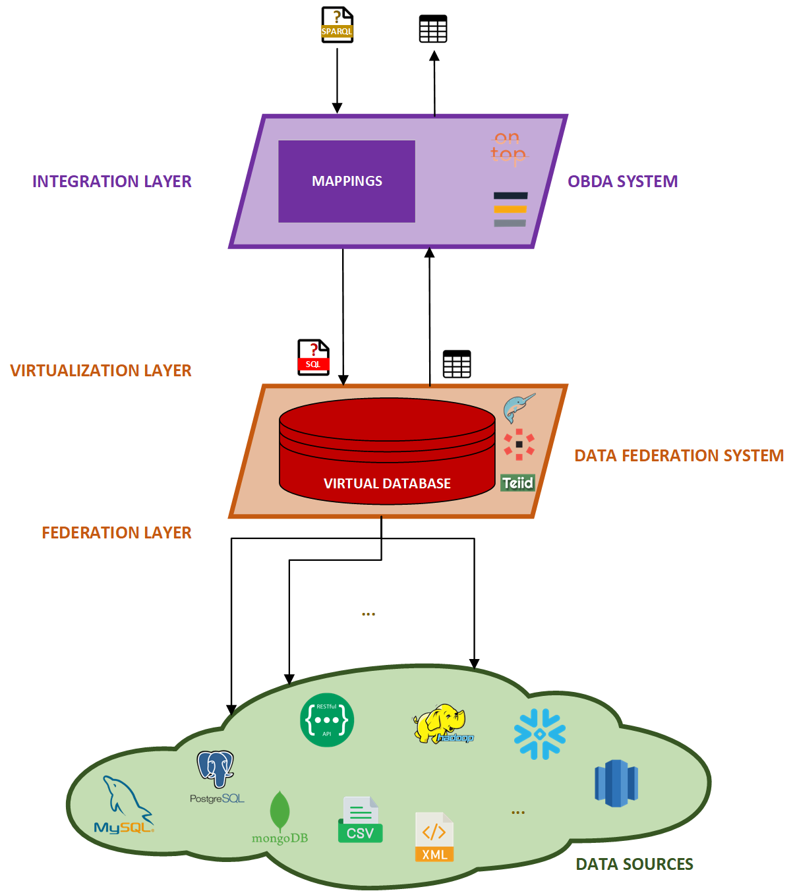
Proposed Solution
Federated Data Analytics System A system designed to integrate and analyze clinical and genomics data seamlessly.
Objective: Enable researchers to perform complex queries across multiple datasets without extensive preprocessing.
Key Components: OBDA, Data Virtualization, Ontology.
This approach reduces complexities in biomedical data management and accelerates research.
Federated Data Analytics for Genomics Data – Cazzaro
2 / 12
Notes:
Utilizzare sempre i modelli di elenco forniti dal programma, quindi non realizzare elenchi solamente inserendo trattini, numeri o punti, affinché una sintesi vocale possa leggerli in ordine e proprio come elenchi.

Slide 4
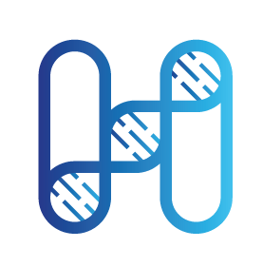


EU Project HEREDITARY
Objective: Transforming our understanding of brain diseases through integrated multimodal data analysis.
Focus Areas:
Integrating genomic and clinical data from various European stakeholders;
Addressing the challenges of data heterogeneity;
Ensuring privacy compliance and data security.
(one of the) Results:
A unified DBMS that supports advanced querying capabilities across different data sources and that allows to gather insightful analytics.
Led by the Department of Information Engineering (UNIPD)
Federated Data Analytics for Genomics Data – Cazzaro
3 / 12
Notes:
Utilizzare sempre i modelli di elenco forniti dal programma, quindi non realizzare elenchi solamente inserendo trattini, numeri o punti, affinché una sintesi vocale possa leggerli in ordine e proprio come elenchi.

Slide 5

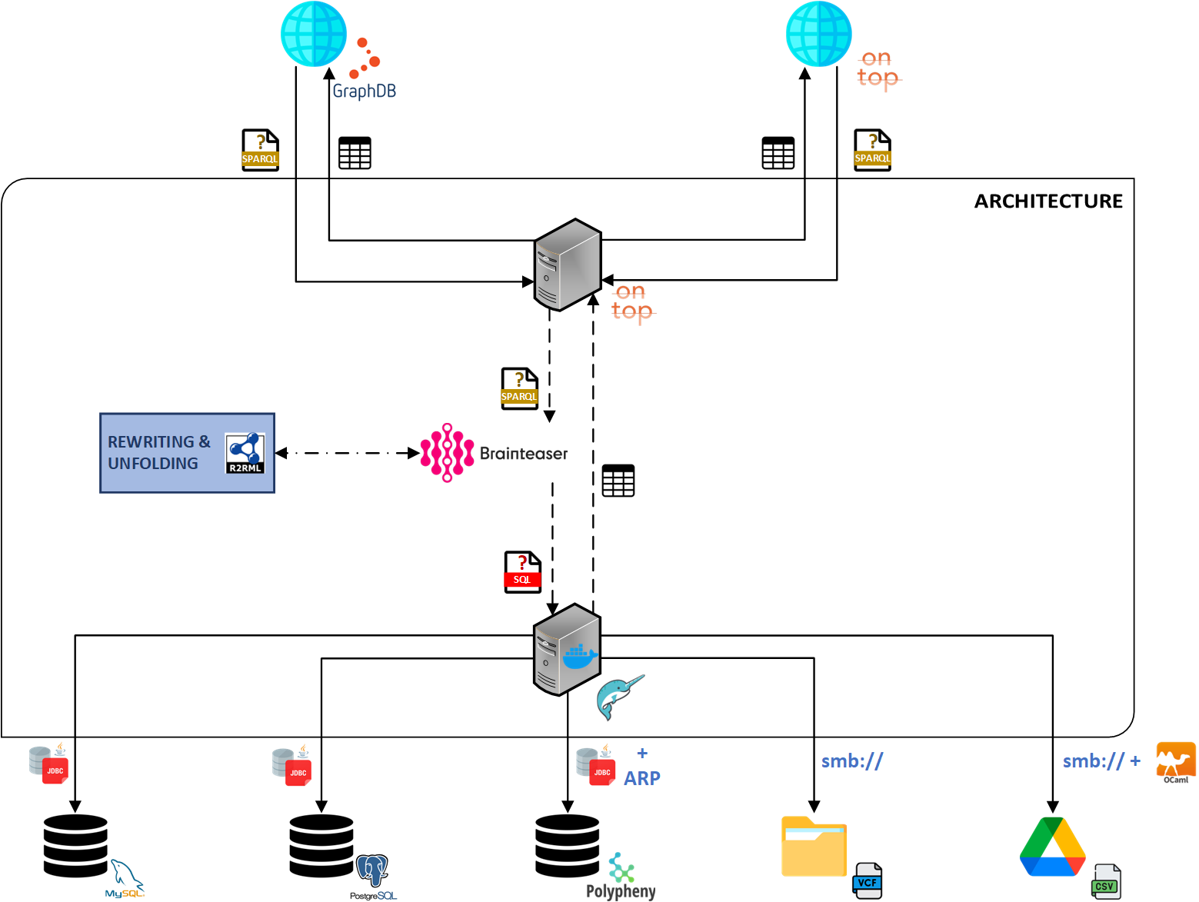



System Architecture
Ontop: Semantic Data Integration Layer.
Dremio: Data Federation and Virtualization Layer.
BRAINTEASER Ontology: Provides the vocabulary structure for querying.
Federated Data Analytics for Genomics Data – Cazzaro
4 / 12
Notes:
Utilizzare sempre i modelli di elenco forniti dal programma, quindi non realizzare elenchi solamente inserendo trattini, numeri o punti, affinché una sintesi vocale possa leggerli in ordine e proprio come elenchi.

Slide 6


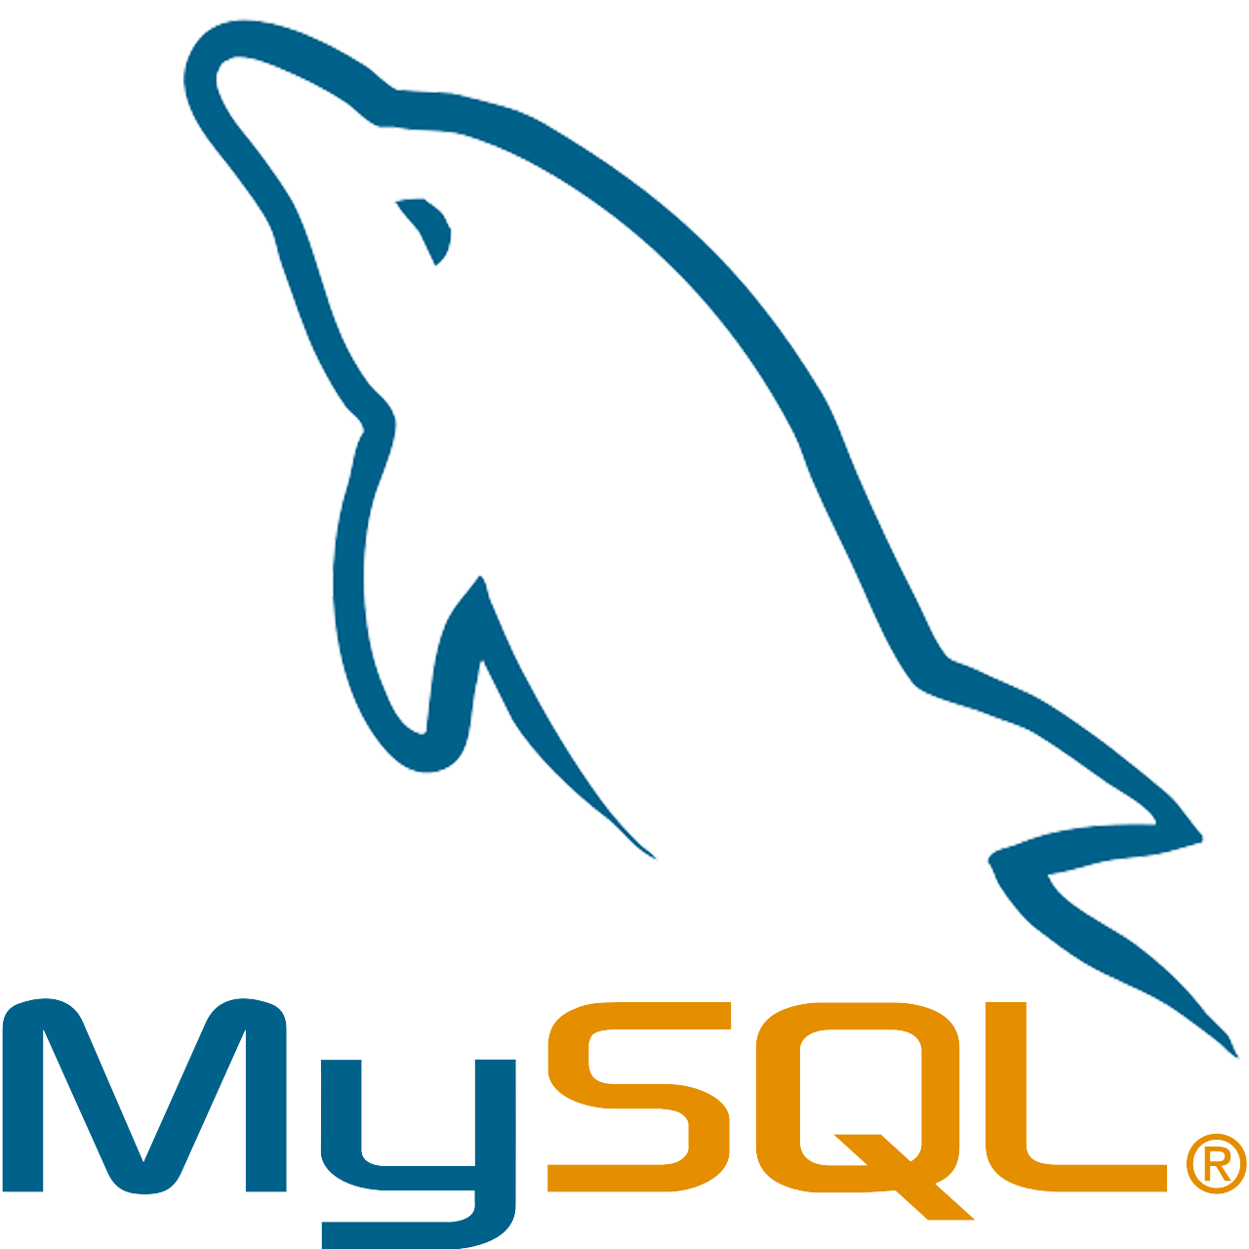




System Architecture – Data Sources
MySQL: Stores structured clinical data.
PostgreSQL: Manages additional clinical datasets.
Polypheny: Supports various data models, enhancing flexibility.
NAS Shared Folders: Hosts genomics data in VCF files.
Google Drive: Integrates a cloud-based storage use case, hosting CSV files.
Each data source is connected via Dremio's federation layer, enabling a unified view across diverse data repositories.
Federated Data Analytics for Genomics Data – Cazzaro
5 / 12
Notes:
Utilizzare sempre i modelli di elenco forniti dal programma, quindi non realizzare elenchi solamente inserendo trattini, numeri o punti, affinché una sintesi vocale possa leggerli in ordine e proprio come elenchi.

Slide 7
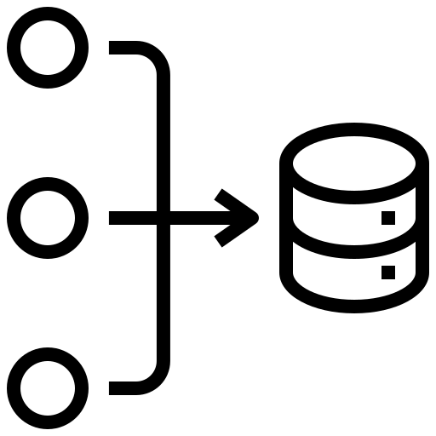
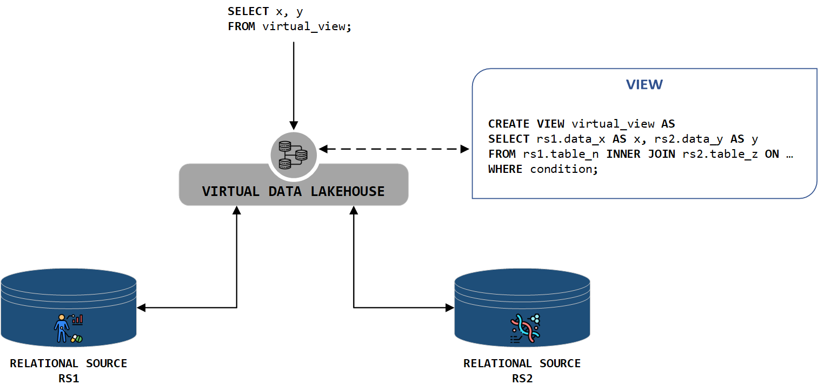
Federation and Virtualization
Virtualization Layer:
Creates virtual views without materializing data, optimizing performance and enabling complex queries across the federated system. Federation Layer: Integrates data across various sources, ensuring seamless access and querying.
Dremio serves as the core engine for both layers, providing a robust platform for handling large-scale data integration tasks.
Federated Data Analytics for Genomics Data – Cazzaro
6 / 12
Notes:
Utilizzare sempre i modelli di elenco forniti dal programma, quindi non realizzare elenchi solamente inserendo trattini, numeri o punti, affinché una sintesi vocale possa leggerli in ordine e proprio come elenchi.

Slide 8

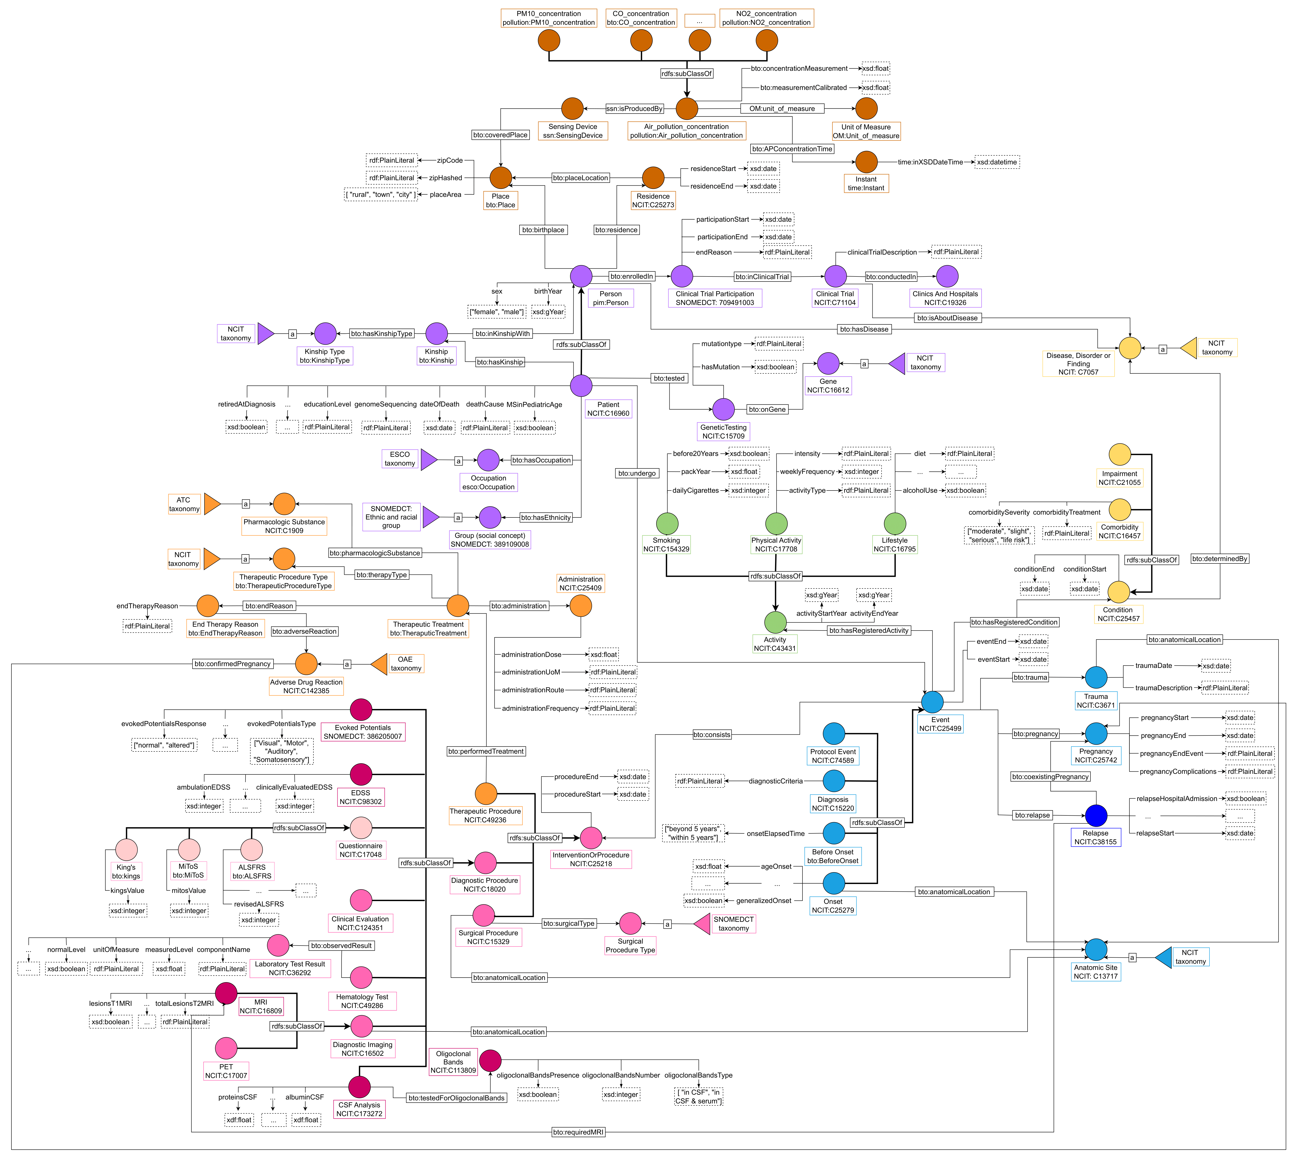
Ontology Integration
The BRAINTEASER Ontology is central to the system Features:
Models relationships between clinical and genomics data;
Enhances query capabilities through semantic enrichment;
Ensures interoperability and scalability.
Federated Data Analytics for Genomics Data – Cazzaro
7 / 12
Notes:
Utilizzare sempre i modelli di elenco forniti dal programma, quindi non realizzare elenchi solamente inserendo trattini, numeri o punti, affinché una sintesi vocale possa leggerli in ordine e proprio come elenchi.

Slide 9

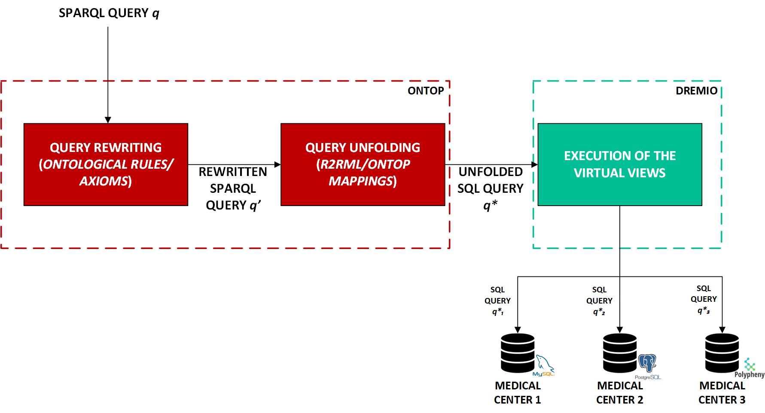
Use Case: ALSFRS Data Querying
Use Case: Querying ALSFRS (Amyotrophic Lateral Sclerosis Functional Rating Scale) data across multiple sources.
SPARQL Query: Retrieves comprehensive patient data;
Process:
Query Rewriting;
Unfolding into SQL;
Execution in Dremio.
Federated Data Analytics for Genomics Data – Cazzaro
8 / 12
Notes:
Utilizzare sempre i modelli di elenco forniti dal programma, quindi non realizzare elenchi solamente inserendo trattini, numeri o punti, affinché una sintesi vocale possa leggerli in ordine e proprio come elenchi.

Slide 10
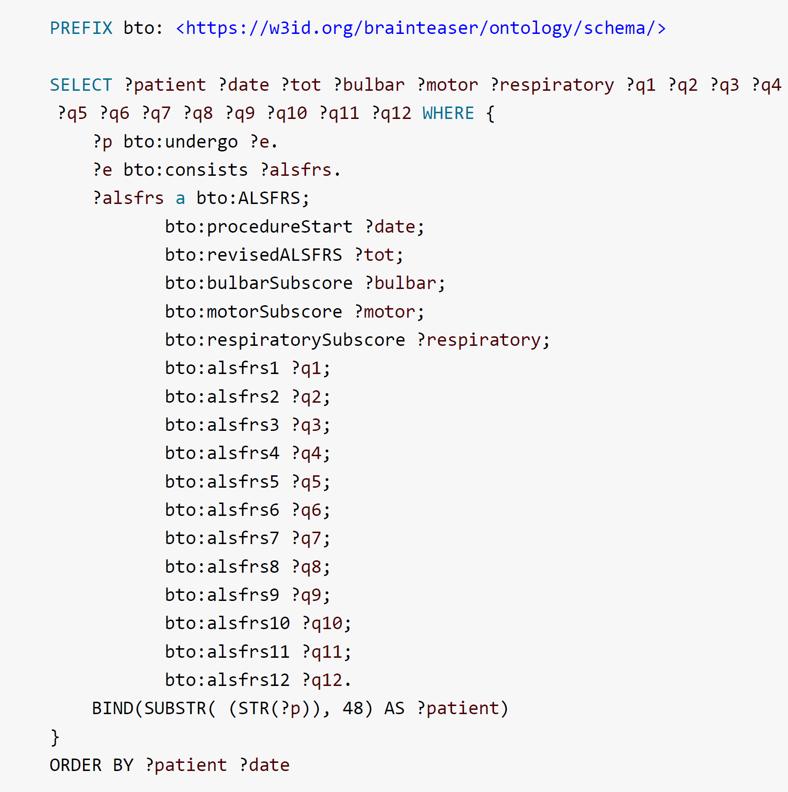
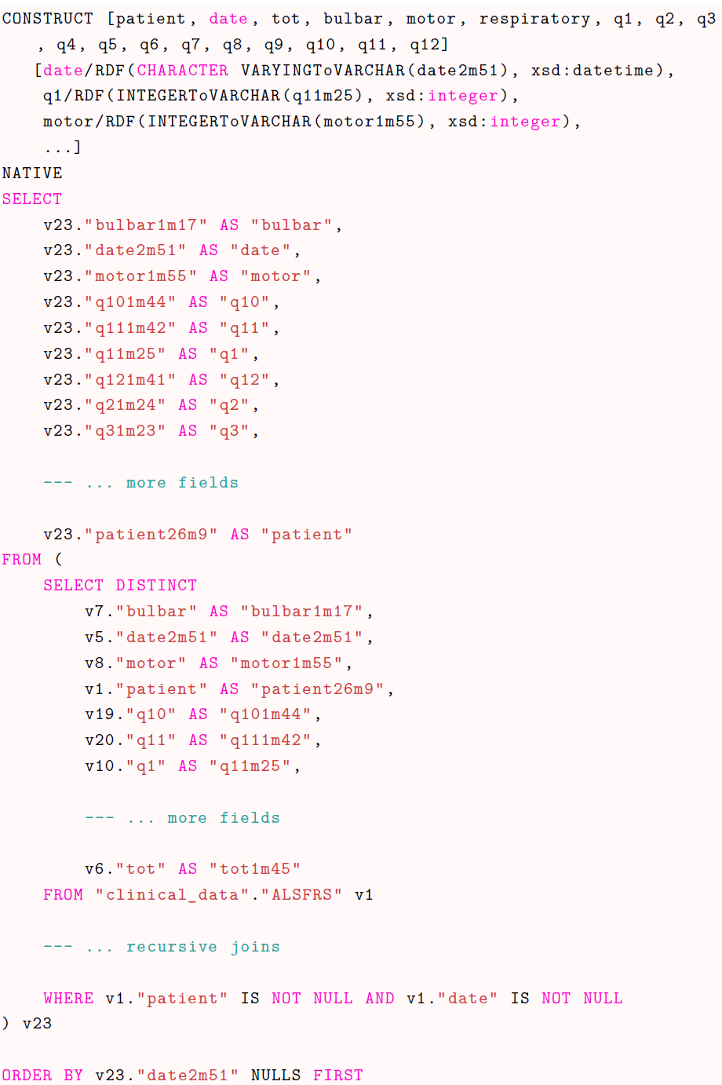
REWRITING + UNFOLDING
Original SPARQL Query
Unfolded SQL Query
Federated Data Analytics for Genomics Data – Cazzaro
9 / 12
Notes:
Utilizzare sempre i modelli di elenco forniti dal programma, quindi non realizzare elenchi solamente inserendo trattini, numeri o punti, affinché una sintesi vocale possa leggerli in ordine e proprio come elenchi.

Slide 11

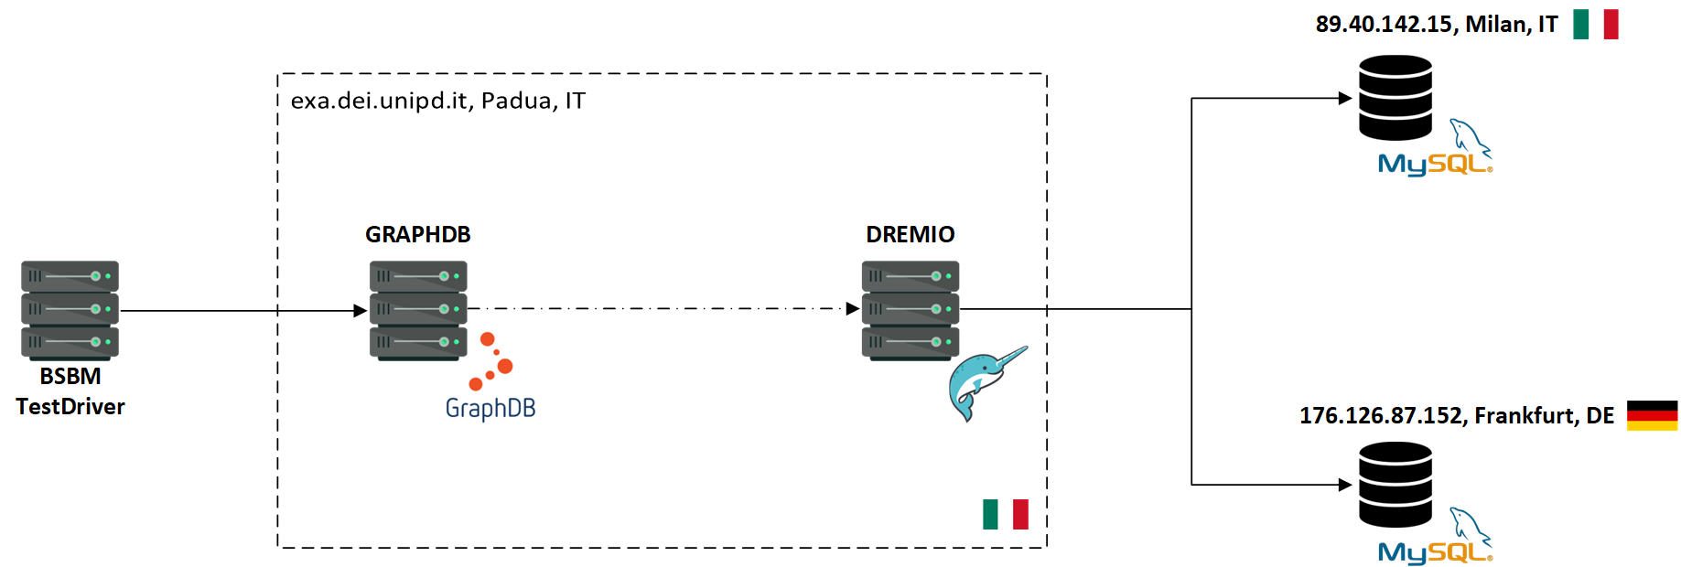
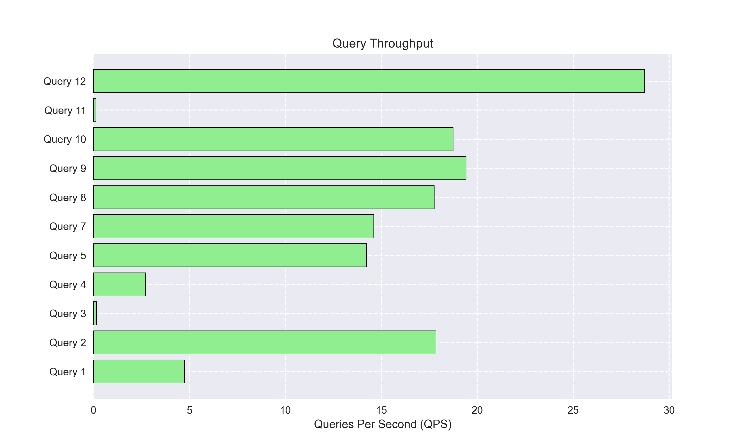
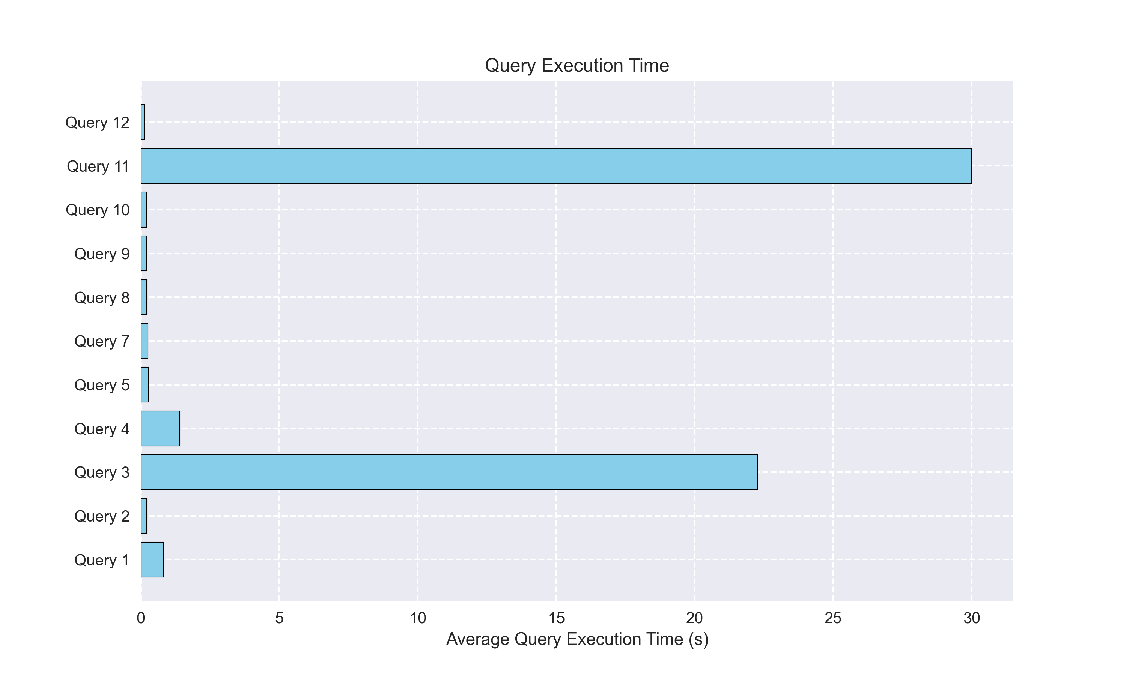
Benchmark 1: BSBM
BSBM Benchmark
Query performances evaluation over a synthetic dataset across diverse sources.
Federated Data Analytics for Genomics Data – Cazzaro
10 / 12
Notes:
Utilizzare sempre i modelli di elenco forniti dal programma, quindi non realizzare elenchi solamente inserendo trattini, numeri o punti, affinché una sintesi vocale possa leggerli in ordine e proprio come elenchi.

Slide 12
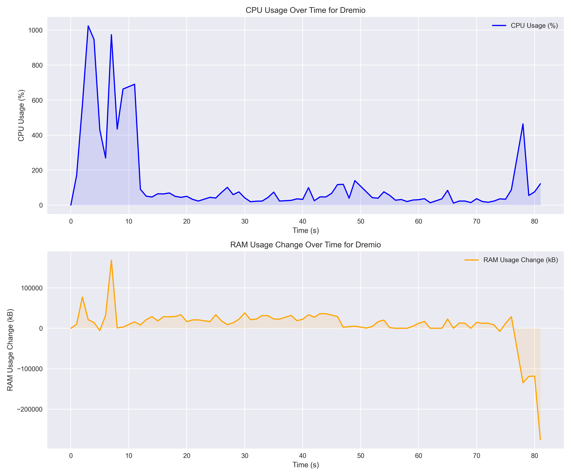
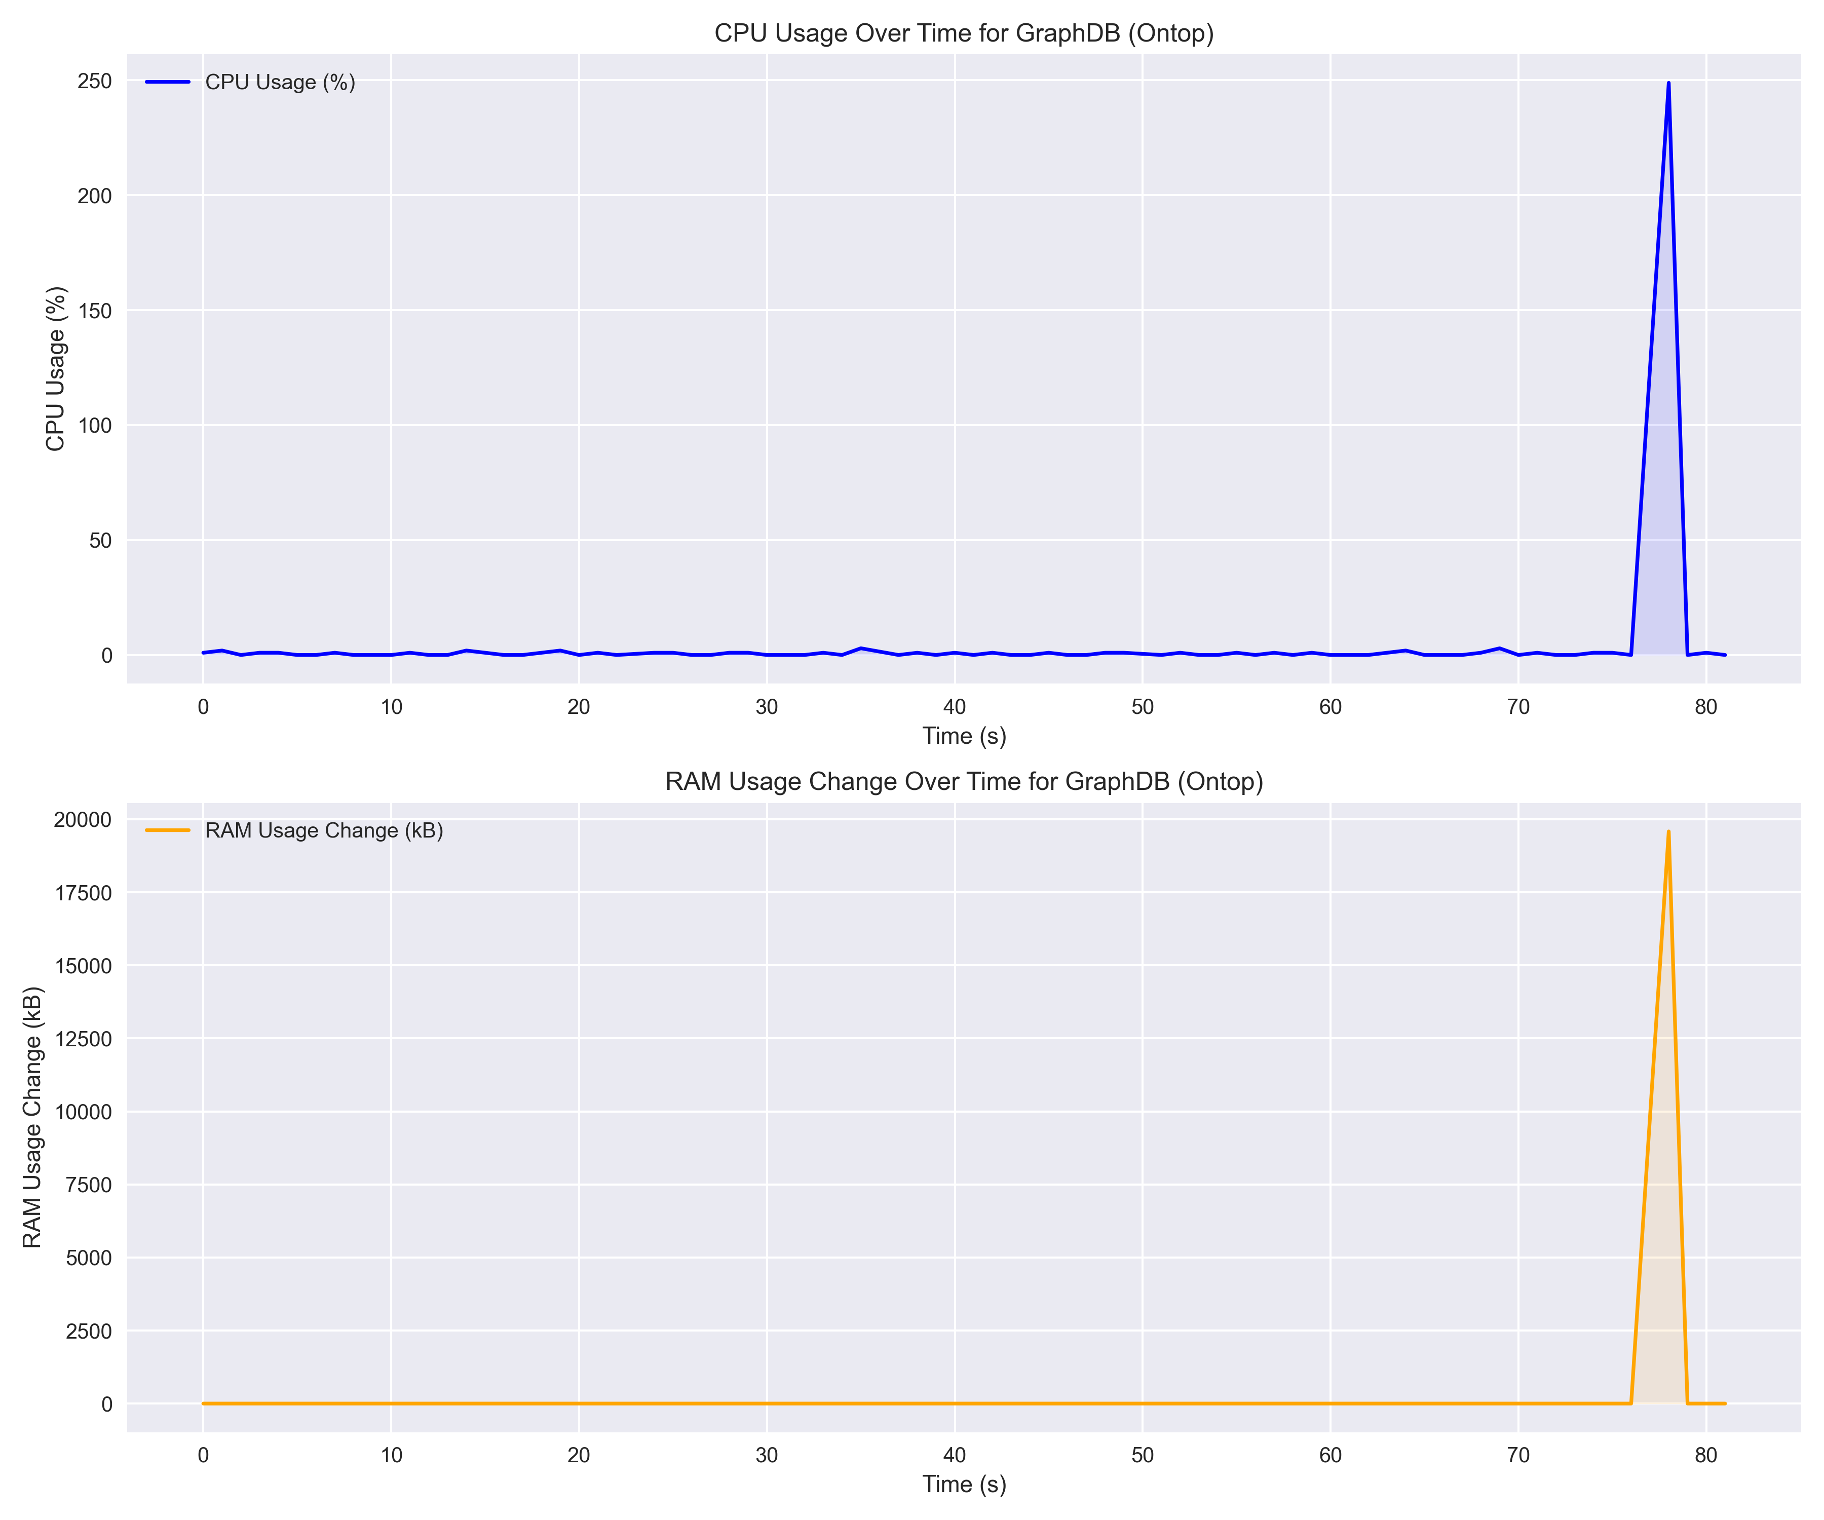
Benchmark 2: SEASHELL
SEASHELL Benchmark
Real-world clinical data highlights system efficiency in handling complex queries.
Dremio
GraphDB
Federated Data Analytics for Genomics Data – Cazzaro
11 / 12
Notes:
Utilizzare sempre i modelli di elenco forniti dal programma, quindi non realizzare elenchi solamente inserendo trattini, numeri o punti, affinché una sintesi vocale possa leggerli in ordine e proprio come elenchi.

Slide 13

Conclusions and Future Works
The federated data analytics system developed in this thesis offers a powerful tool for integrating and analyzing heterogeneous biomedical data.
Future Directions:
Optimization: Improve architecture performances, considering SEASHELL monitoring data as an entry point;
Privacy: Strengthen data security and compliance with regulations, such as GDPR;
Usability: Simplify both the architecture usage and deployment, so to reach a larger audience.
This system lays the groundwork for future advancements in biomedical data research, contributing to better healthcare outcomes.
Federated Data Analytics for Genomics Data – Cazzaro
12 / 12
Notes:
Utilizzare sempre i modelli di elenco forniti dal programma, quindi non realizzare elenchi solamente inserendo trattini, numeri o punti, affinché una sintesi vocale possa leggerli in ordine e proprio come elenchi.

Slide 14


Thank You!
Do you have any question?
Master Degree Course in Computer Engineering – Web Information and Data Engineering (WIDE)
A. A. 2023/2024

